Slide 1
Lecture3: Intelligent Agents, & AI Related Disciplines
2.1 Intelligent “Rational” Agents?
Recap: AI as the Study & Design of
Intelligent Agents
Intelligent Agents in the World
An Example: Vacuum_Agent
Specifying the Task Environment [ PEAS ]
Goad-based vs. Cost-based Agents
2.2 Specifying the Task Environment
Environment Types
2.3 AI: Related Disciplines
Learning Agents
AI vs. Machine Learning vs. Deep Learning
Machine Learning?
Datamining?
AI vs. Data Science
Why Data Science?
Why Big Data?

Slide 2

Environment Types
Fully Observable
vs.
Partially
Observable
Deterministic
vs.
(vs. Strategic)
Stochastic
Episodic
vs.
Sequential
Static
vs. Dynamic
(vs. Semi-Dynamic)
vs. Continuous
vs. Multi-Agent
vs. Unknown
Discrete
Single-Agent
Known
27

Slide 3
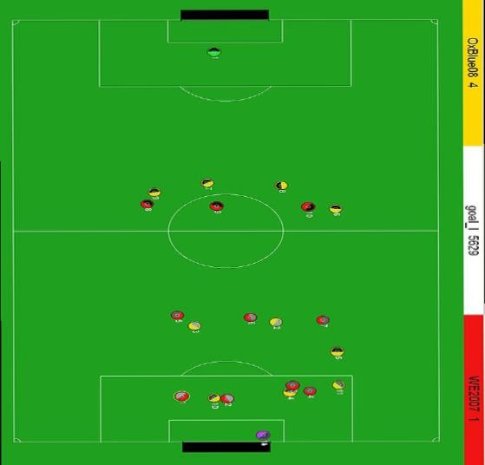
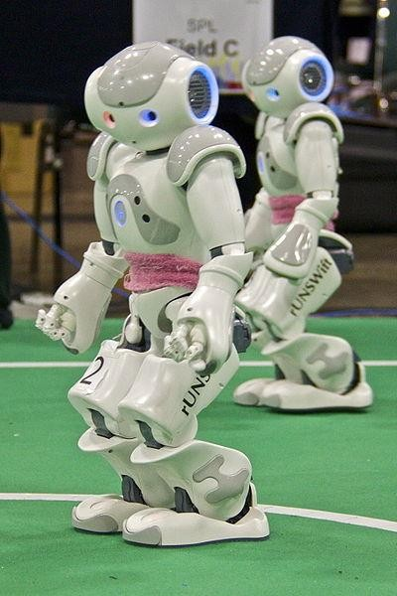
Fully Observable vs. Partialy Observable
Do the agent's sensors give it access to the complete state of the
environment?
For any given world state, are the values of all the variables known to the agent?
vs.
28
Source: L. Zettlemoyer

Slide 4
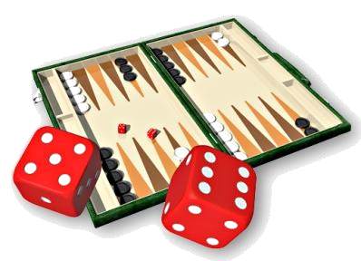
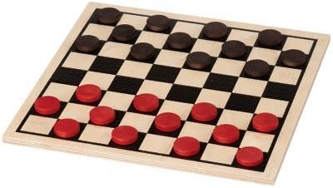
Deterministic vs. Stochastic (vs. Strategic)
Is the next state of the environment completely determined by the current state and the agent’s action?
Is the transition model deterministic (unique successor state given current state and action) or stochastic (distribution over successor states given current state and action)?
Strategic: the environment is deterministic except for the actions of other agents.
vs.

Slide 5
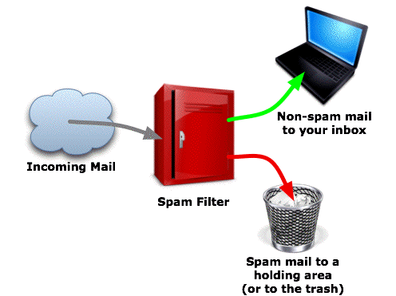
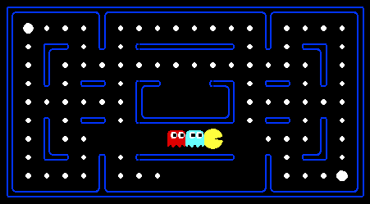
Episodic vs. Sequential
o Is the agent’s experience divided into unconnected single decisions/actions, or is it a coherent sequence of observations and actions in which the world evolves according to the transition model?
vs.

Slide 6
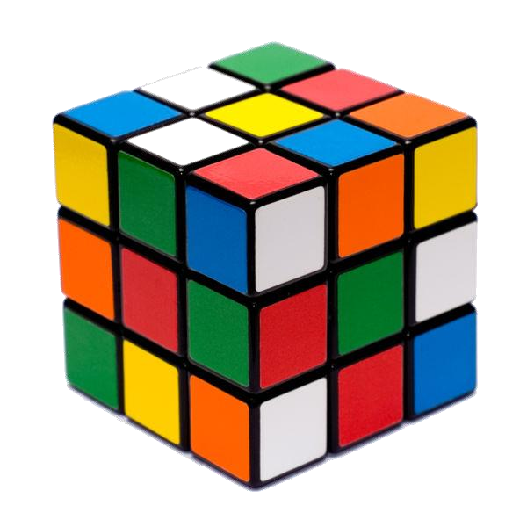

Static vs. Dynamic (vs. Semi-dynamic)
Is the world changing while the agent is thinking?
Semi-dynamic: the environment does not change with the passage of time, but the agent's performance score does.
vs.

Slide 7
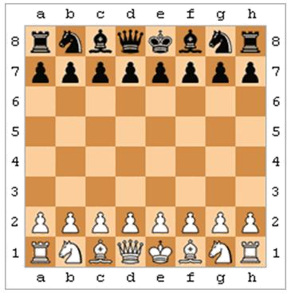
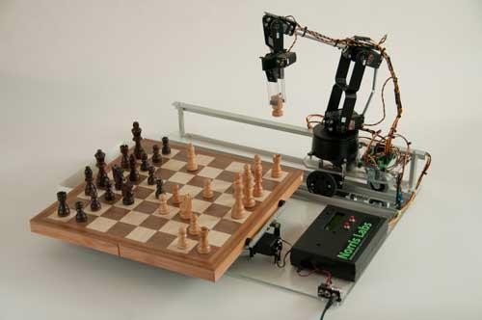
Discrete vs. Continuous
Does the environment provide a fixed number of distinct
percepts, actions, and environment states?
Are the values of the state variables discrete or continuous?
Time can also evolve in a discrete or continuous fashion.
vs.

Slide 8
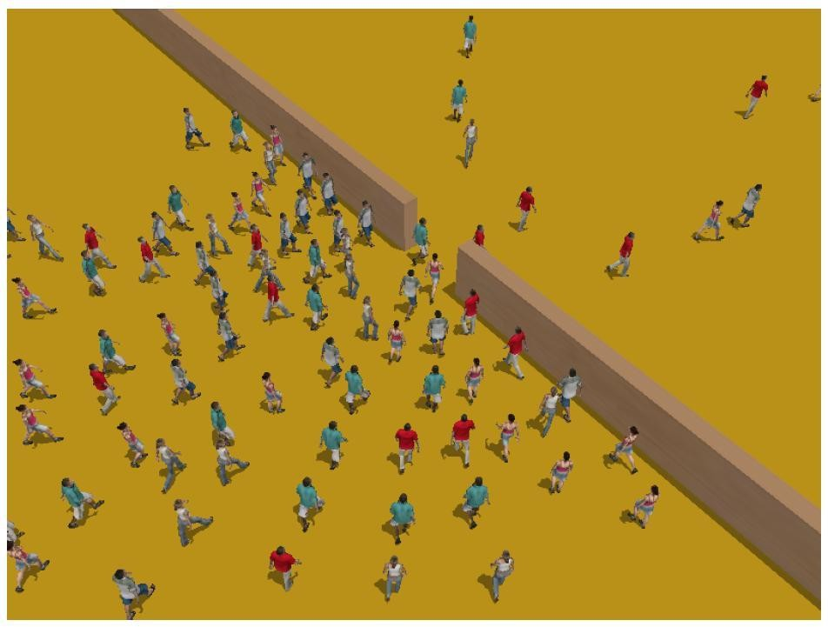
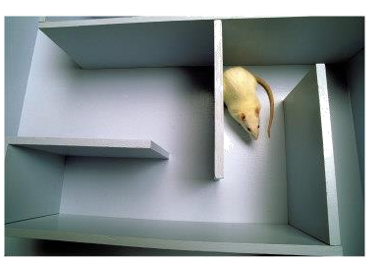
Single–Agent vs. Multi–Agent
Is an agent operating by itself in the environment?
Is the environment of an autonomous taxi driver a competitive multiagent environment or a cooperative multiagent environment?
vs.

Slide 9

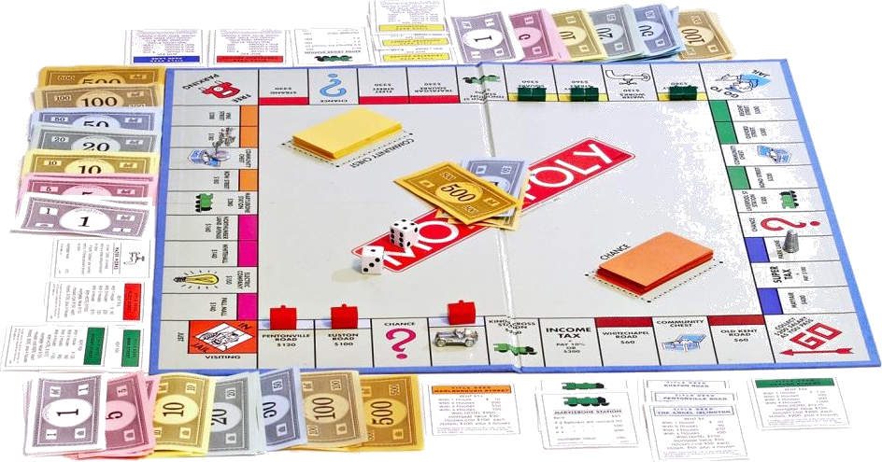
Known vs. Unknown
Are the rules of the environment (transition model and rewards
associated with states) known to the agent?
Strictly speaking, not a property of the environment, but of the
agent’s state of knowledge.
vs.

Slide 10
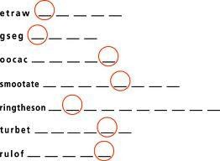
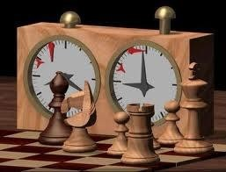
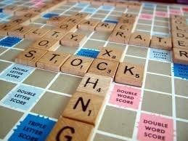
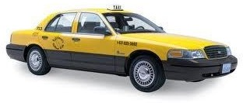
Examples of the different environments
 | Word Jumble Solver | Chess with a Clock | Scrabble | Autonomous Driving
Observable | Fully | Fully | Partially | Partially
Deterministic | Deterministic | Strategic | Stochastic | Stochastic
Episodic | Episodic | Sequential | Sequential | Sequential
Static | Static | Semi-dynamic | Static | Dynamic
Discrete | Discrete | Discrete | Discrete | Continuous
Single agent | Single | Multi | Multi | Multi

Slide 11


Exercises
What have we learned?
Is the environment of an autonomous taxi driver a competitive
multiagent environment or a cooperative multiagent environment?
Characterize the following Task Environments: Poker Game .
Is the distinction between known and unknown environments the same
as the one between fully observable and partially observable?
Describe briefly the following statements (while giving an example):
Episodic environments are much simpler than sequential environments because the agent does not need to think ahead.

Slide 12
Lecture 2: Intelligent Agents, & AI Related Disciplines
2.1 Intelligent “Rational” Agents?
Recap: AI as the Study & Design of
Intelligent Agents
Intelligent Agents in the World
An Example: Vacuum_Agent
Specifying the Task Environment [ PEAS ]
Goad-based vs. Cost-based Agents
2.2 Specifying the Task Environment
Environment Types
2.3 AI: Related Disciplines
Learning Agents
AI vs. Machine Learning vs. Deep Learning
Machine Learning?
Datamining?
AI vs. Data Science
Why Data Science?
Why Big Data?

Slide 13

Artificial Intelligence
Related Disciplines
39

Slide 14

MainResourcesforthis Section
The following courses:
Data Science, Harvard University (School of Engineering & Applied Sciences)
Introduction to Data Science - Data Intensive Computing, University of Florida
Introduction to Data Science, University
of California - Berkeley
Practical Data Science: Introduction,
Carnegie Mellon University
40

Slide 15
Learning Agents?
"Of particular interest in AI are Learning agents, which are
capable of changing themselves given training examples or through positive or negative feedback, such that the average utility of their actions grows over time."
- Wolfgang Ertel, "Introduction to Artificial Intelligence," 2nd Edition (2017)
41

Slide 16
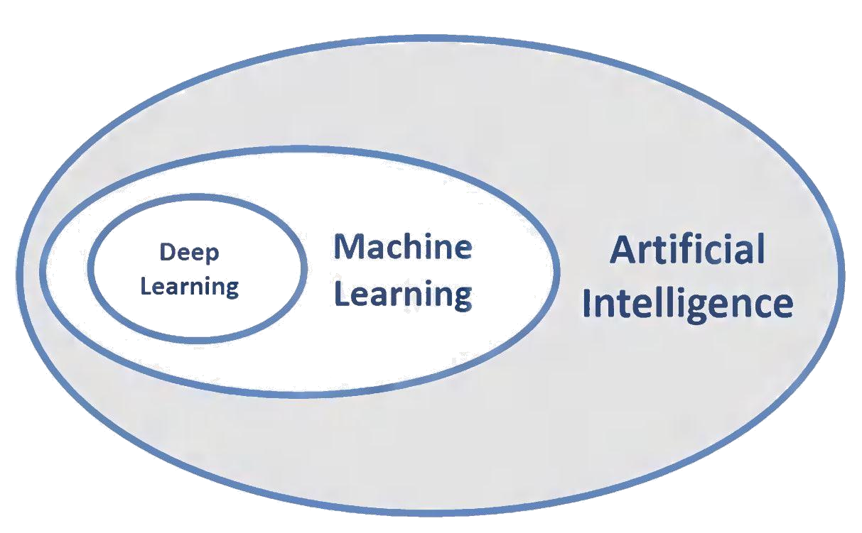
Artificial Intelligence Vs. Machine Learning Vs. Deep Learning ..
A formal short answer:
Deep Learning is a part of Machine Learning, which is a part of AI.
https://human-centered.ai/2017/11/11/difference-ai-ml/
42

Slide 17
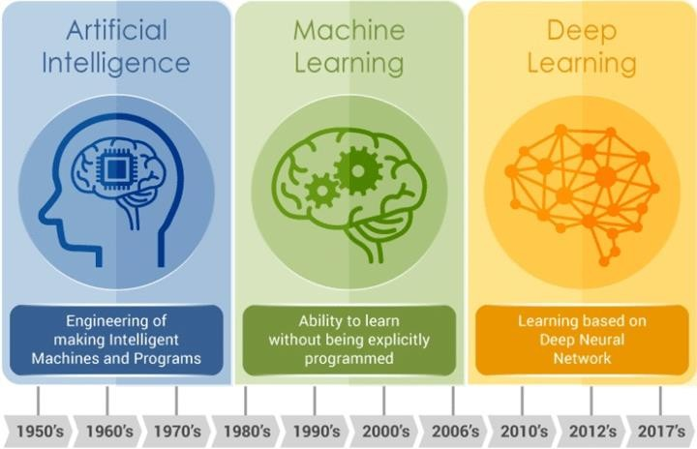
Artificial Intelligence Vs. Machine Learning Vs. Deep Learning ..
Evolution of AI — Source: https://www.embedded-vision.com/
43

Slide 18
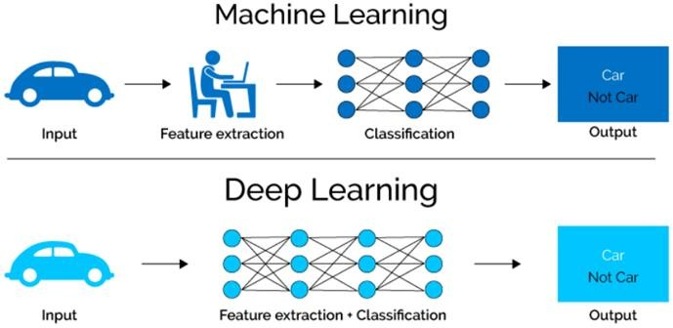
Machine Learning Vs. Deep Learning ..
https://www.upwork.com/hiring/for-clients/artificial-intelligence-and-natural-language-processing-in-big-data/
44

Slide 19
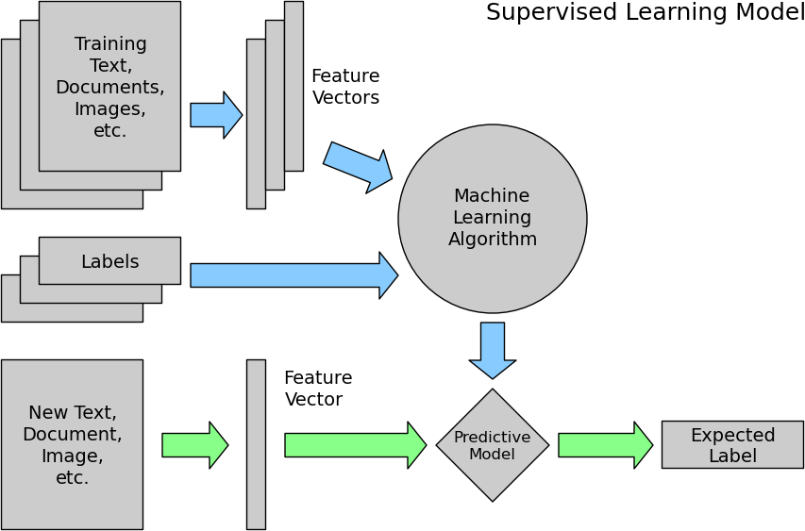
Machine Learning?
G e n e r i c M a c h i n e L e a r n i n g M o d e l s

Slide 20
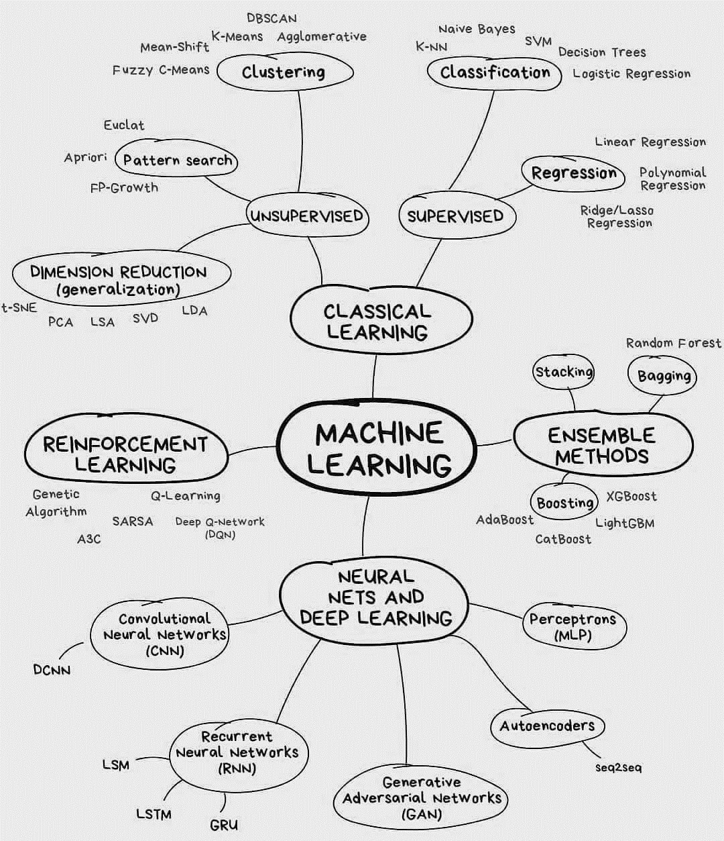
Machine Learning?
{ Artif i c i a l
I ntel l i gence }
M a c h i n e
L e a r n i n g M a p

Slide 21
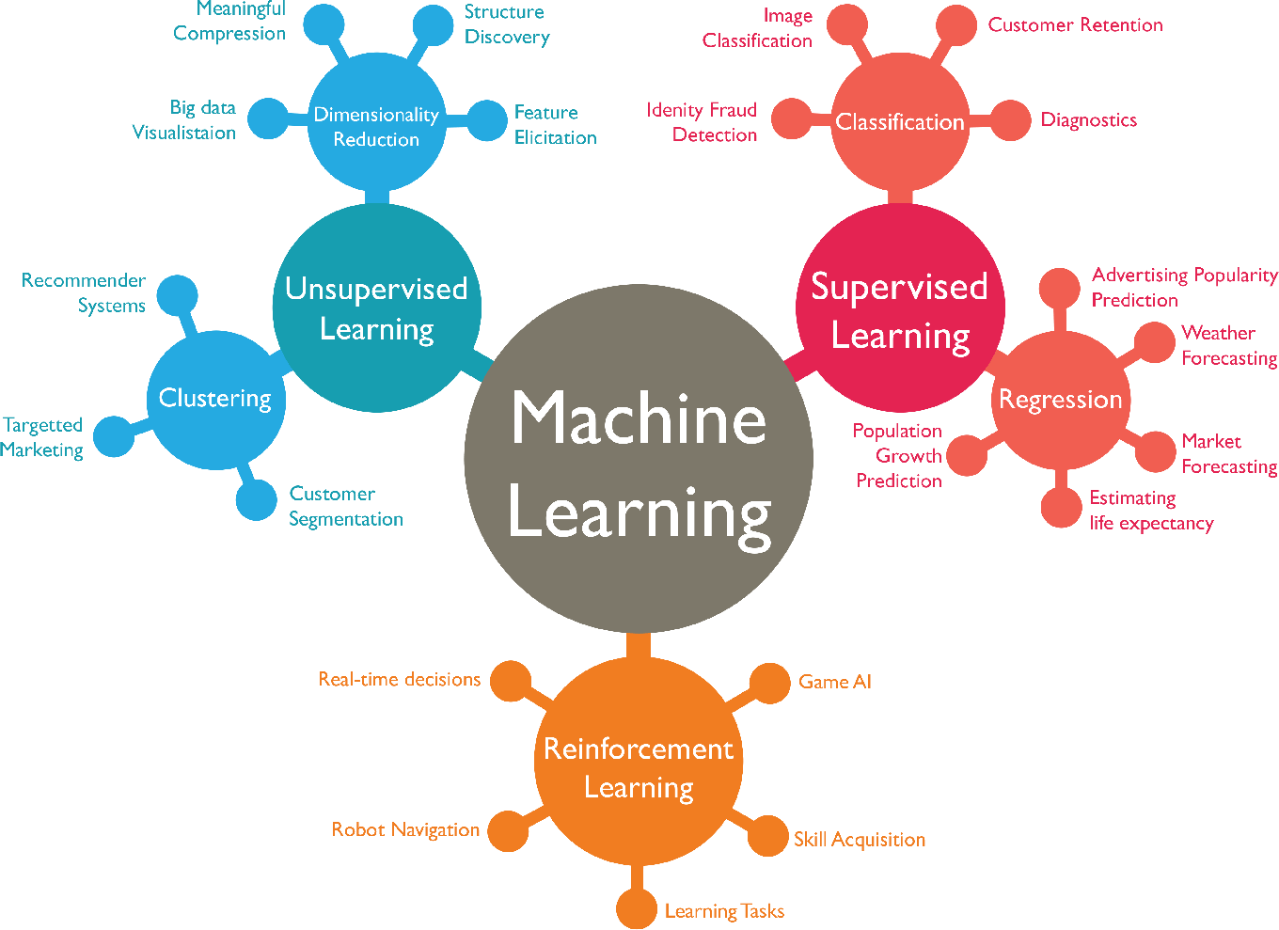
Machine Learning Approaches & their corresponding Applications

Slide 22




What about Data-Mining?
Machine learning and data mining often employ methods and overlap significantly. They can be
the same
roughly
distinguished as follows:
Machine learning focuses on prediction, based on known
properties learned from the training data.
Data mining focuses on the discovery of (previously) unknown properties in the data. This is the analysis step of Knowledge Discovery in Databases.
Much of the confusion between these two research communities comes from the basic assumptions they work with: in machine learning, performance is usually evaluated with respect to the ability to reproduce known knowledge, while in Knowledge Discovery and Data Mining (KDD) the key task is the discovery of
previously unknown knowledge.
48

Slide 23












Artificial Intelligence Vs. Data-Science
DataScience-Some PossibleDefinitions:
Data Science is the science which uses computer science, statistics and machine learning, visualization and human- computer interactions to collect, clean, integrate, analyse, visualize, interact with data to create data products.
Data science = statistics + data processing + machine learning + scientific inquiry + visualization + business analytics + big data + …

Slide 24
WhyDataScience?
in 20th Century Innovations ..
Engineering and Computer Science played key role:
Cars
Airplanes
Power grid
Television
Air conditioning and central heating
Nuclear power
Digital computers
The internet

Slide 25
WhyDataScience?
But how about these 20th Century questions?
Does fertilizer increase crop yields?
Does Streptomycin cure Tuberculosis?
Does smoking cause lung-cancer?

Slide 26
WhyDataScience?
What is the difference? .. Data
Does fertilizer increase crop yields?
Answer: Collect and analyse agricultural experimental data.
Does Streptomycin cure Tuberculosis?
Answer: Collect and analyse randomized trials data.
Does smoking cause lung-‐cancer?
Answer: Collect and analyse observational studies data.
Deductive versus empirical ..
Solutions deduced mostly from theory versus solutions deduced from mostly from data ..

Slide 27
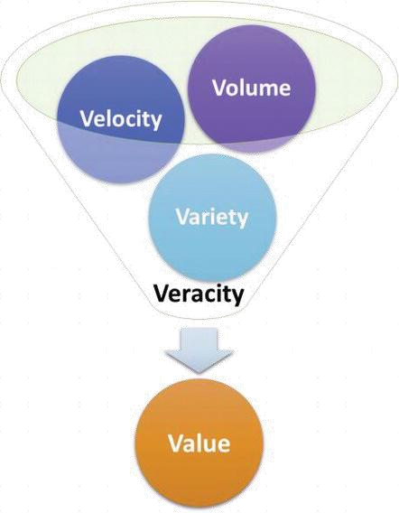





TheDawnofBigData
To understand the phenomenon that is big data, it is often described using five Vs: Volume, Velocity, Variety, Veracity, and Value.
Recently, Visualization, Virality, & Viscosity were added (thus, Eight Vs) ..
Source: https://www.intechopen.com/books/artificial-intelligence-scope-and-limitations/prediction- of-cancer-patient-outcomes-based-on-artificial-intelligence
53

Slide 28
TheDawnofBigData
Volume refers to the vast amounts of data generated every second.
Velocity refers to the speed at which new data is generated and the speed at which data moves around.
Variety refers to the different types of data we can now use. In fact, 80% of the world’s data is now unstructured, and therefore can’t easily be put
into tables (think of photos, video sequences or social media updates).
Veracity refers to the messiness or trustworthiness of the data. With many forms of big data, quality and accuracy are less controllable.
Value; It is all well and good having access to big data but unless we can
turn it into value it is useless.
54

Slide 29
